Slide 1
y
220°
40°
x

Slide 2
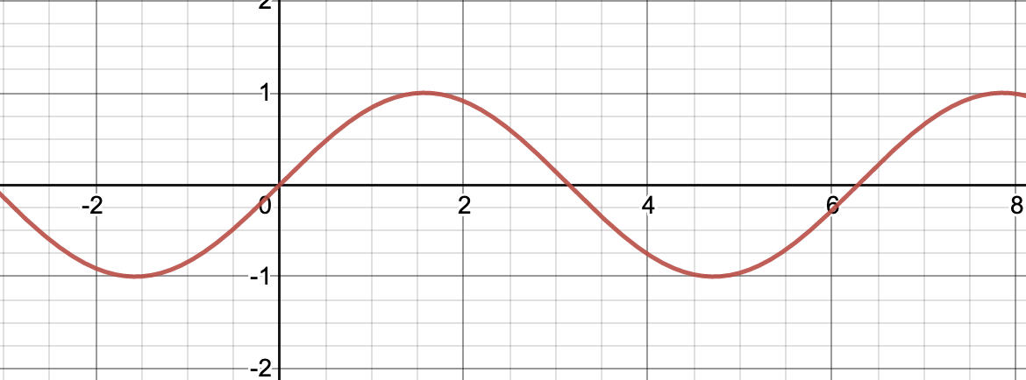
Period
Amplitude
Base line / Equilibrium position
2π/3
π/2
π
2π

Slide 3
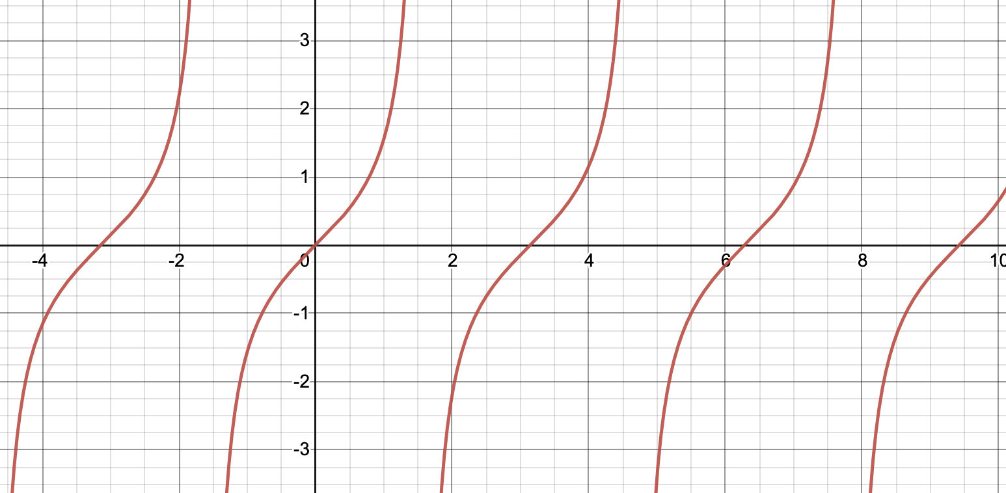
– 3π/2
– π/2
π/2
3π/2
5π/2
– π
π
2π
3π

